Slide 1

DEPARTMENT OF COMPUTER SCIENCE AND ENGINEERING
III – B.Tech – I – Sem
ARTIFICIAL INTELLIGENGE
(R20 Regulations)
11

Slide 2

ARTIFICIAL INTELLIGENCE
- The Future

Slide 3
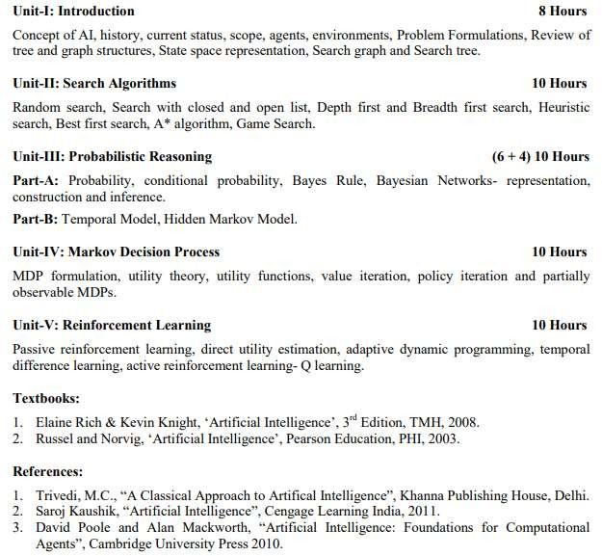
SYLLABUS

Slide 4
COURSE OUTCOMES
Upon completion of the course, the student will be able
CO 1: To explain the concepts of artificial intelligence
(Unit – I)
CO 2: To illustrate various search algorithms
(Unit – II)
CO 3: To adapt various probabilistic reasoning approaches (Unit – III)
CO 4: To elaborate Markov decision process
(Unit – IV)
CO 5: To perceive various reinforcement learning approaches (Unit – V)

Slide 5
UNIT – I
Introduction
Concept of AI
History
Current status
Scope
Agents
Environments
Problem Formulations
Review of Tree and Graph Structures
State Space Representation
Search Graph and Search Tree

Slide 6
Senses of Human Being
Taste
Smell
Vision
Hearing
Touch
However,
sense," called
an under-appreciated "sixth Consciousness (proprioception)
allows us to keep track of where our body parts are in space.
This sixth sense is a unique characteristic of a human being.

Slide 7
Human | Machine
Human is made of Flesh & Blood | No life for machine, Machines are mechanical life
Human have feelings and emotions | Machines don't have feelings and emotions
Human can do anything | Machines can't do
Human have the capability of understanding the situations | Machines can't understand
Human perform the tasks as per own intelligence | But Machines only have AI
Human brains are analog | Machine brains are digital

Slide 8
What is Artificial Intelligence?
Artificial Intelligence is composed of two
power", hence AI means "a man-made thinking power.“
"It is a branch of computer science by which we can create intelligent machines which can behave like a human, think like humans, and able to make decisions.“
With Artificial Intelligence you do not need to preprogram a machine to do some work, despite that you can create a machine with programmed algorithms which can work with own intelligence, and that is the awesomeness of AI.
words | Artificial and Intelligence, | where | Artificial
defines | "man-made," and intelligence | defines | "thinking

Slide 9
Why Artificial Intelligence?
With the help of AI, you can create such software or devices which can solve real-world problems very easily and with accuracy such as health issues, marketing, traffic issues, etc.
With the help of AI, you can create your personal virtual Assistant, such as Cortana, Google Assistant, Siri, etc.
With the help of AI, you can build such Robots which can work in an environment where survival of humans can be at risk.
AI opens a path for other new technologies, new devices, and new Opportunities.

Slide 10
Goals of Artificial Intelligence
Replicate human intelligence
Solve Knowledge-intensive tasks
An intelligent connection of perception and action
Building a machine which can perform tasks that requires human intelligence such as:
Proving a theorem
Playing chess
Plan some surgical operation
Driving a car in traffic

Slide 11
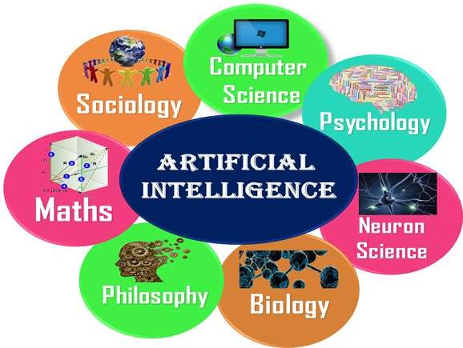
What Comprises to Artificial Intelligence?
AI is a combination of Reasoning, learning, problem-solving perception, language understanding, etc.
To achieve the above factors for a machine or software Artificial Intelligence requires the following discipline:

Slide 12
Advantages of Artificial Intelligence
High Accuracy with less errors: AI machines or systems are prone to less errors and high accuracy as it takes decisions as per pre-experience or information.
High-Speed: AI systems can be of very high-speed and fast-decision making, because of that AI systems can beat a chess champion in the Chess game.
High reliability: AI machines are highly reliable and can perform the same action multiple times with high accuracy.
Useful for risky areas: AI machines can be helpful in situations such as defusing a bomb, exploring the ocean floor, where to employ a human can be risky.

Slide 13
Digital Assistant: AI can be very useful to provide digital assistant to the users such as AI technology is currently used by various E-commerce websites to show the products as per customer requirement.
Useful as a public utility: AI can be very useful for public utilities such as a self-driving car which can make our journey safer and hassle-free, facial recognition for security purpose, Natural language processing to communicate with the human in human-language, etc.

Slide 14
Disadvantages of Artificial Intelligence
High Cost: The hardware and software requirement of AI is very costly as it requires lots of maintenance to meet current world requirements.
Can't think out of the box: Even we are making smarter machines with AI, but still they cannot work out of the box, as the robot will only do that work for which they are trained, or programmed.
No feelings and emotions: AI machines can be an outstanding performer, but still it does not have the feeling so it cannot make any kind of emotional attachment with human, and may sometime be harmful for users if the proper care is not taken.
Increase dependency on machines: With the increment of technology, people are getting more dependent on devices
and hence they are losing their mental capabilities.
14

Slide 15
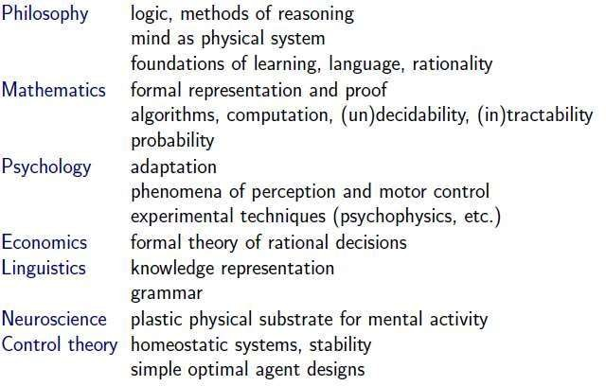
Foundations or Prehistory of AI
AIAIPrehistory

Slide 16
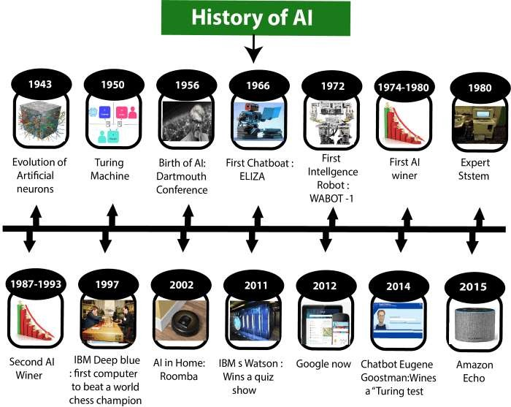

Slide 17
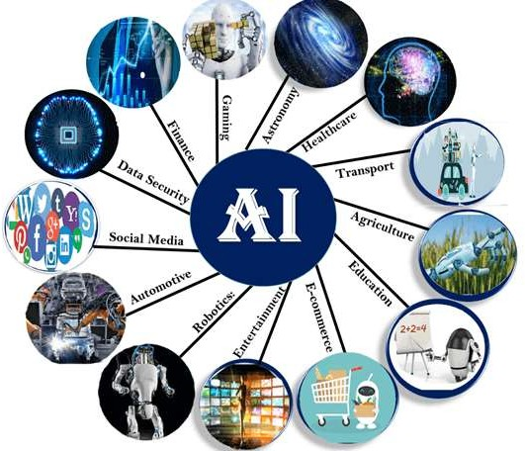
Applications of Artificial Intelligence

Slide 18
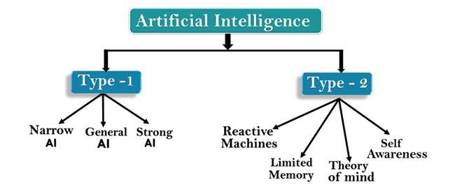
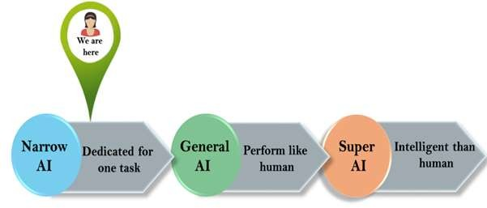
Types of Artificial Intelligence
AI type-1 &2: Based on Capabilities & Functionality

Slide 19
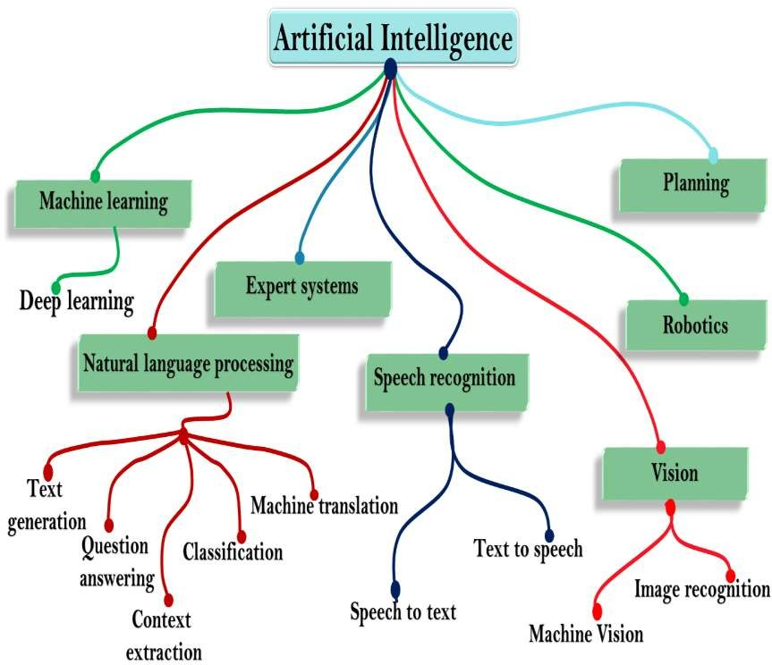
Subsets of Artificial Intelligence

Slide 20
State of Art (Current Status & Scope)
The State of the Art(SOTA) in Artificial Intelligence follows the reduction rule:
SOTA AI = Data Science = Machine Learning = Deep Learning = Narrow/Weak AI
Or, DS < DL < ML = NSAI (New-Smart AI) < AI
The SOTA AI, as specific ML/DL models, algorithms, techniques and technologies, it is what makes today's commercially prevalent weak AI.
The SOTA AI is still after building machines and software agents somehow mimicking human-like cognition and intelligence (sense (perceiving), analysis, reasoning, understanding and response) by means of statistic learning techniques.

Slide 21
Most present AI companies, from big tech to startups, are about some advanced data analytics, predictive modeling, or computational neural networks based on mathematics and algorithms, as some specific ML/DL techniques, algorithms, models or applications.
They are outperforming humans in some very narrowly defined task, focusing on imitating, simulating or faking some single cognitive ability, skill or competence.
Such a narrow weak AI can identify the patterns and correlations from big data streams while failing to discover real rules and causal patterns.
The SOTA AI is on the way to out-perform humans in detecting diseases, bank fraud, flying aircraft, translating between languages, recognizing faces, speech, emotions, trading stocks, social network filtering, aggregating news, painting, playing music, chess or Go, making purchase suggestions, sales predictions, weather forecasting, playing video games, strategic games, quiz shows, or driving cars.

Slide 22
The SOTA AI is widely used in e-commerce, social networks, internet search, automobile, logistic, healthcare, stock-trading, robotics, finance, transport, education, and other industries.
Still, it is hardly any real AI, aimed to integrate all the specific ML/DL/NSAI models, algorithms, techniques and technologies what make today's AI.
For, as a matter of fact, DS < DL < ML < NSAI << Real/True/Global AI As a result, there are three different types of AI companies: the SOTA AI
companies (data
companies
analytics companies (80%) and machine
AI
learning
(0,1%).
(19,9%)) and Real
companies

Slide 23
Scope of Artificial Intelligence
AI in Science and Research
AI in Cyber Security
AI in Data Analysis
AI in Transport
AI in Home
(https://www.upgrad.com/blog/future-scope-of-artificial-
intelligence/)

Slide 24
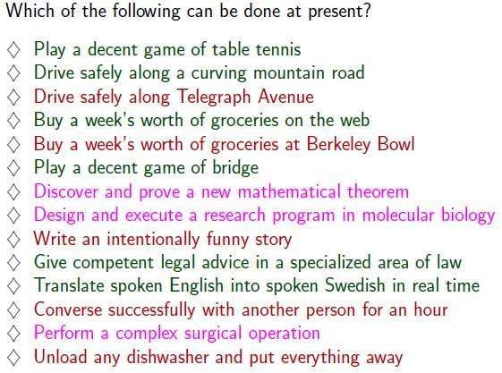
State of Art (Current Status & Scope)

Slide 25
INTELLIGENCE
The capacity to learn and solve problems.
In particular,
the ability to solve novel problems (i.e solve new problems)
the ability to act rationally (i.e act based on reason)
the ability to act like humans
the ability to deal with unexpected problems, uncertainties (reasoning and planning)

Slide 26
Definitions: Artificial Intelligence
Artificial Intelligence is the branch of computer science concerned with making computers behave like humans.
Major AI textbooks define artificial intelligence as "the study and design of intelligent agents," where an intelligent agent is a system that perceives its environment and takes actions which maximize its chances of success.
John McCarthy, who coined the term in 1956, defines it as "the science and engineering of making intelligent machines, especially intelligent computer programs."

Slide 27
―The exciting new effort to make computers think
… machines with minds, in the full and literal sense -- Haugeland, 1985
SOME OTHER DEFINITIONS OF AI
Building systems that think like humans
―The automation of activities that we associate with human thinking, … such as decision- making, problem solving, learning, …-- Bellman, 1978
Building systems that act like humans
―The art of creating
machines
that perform functions that require intelligence when
performed by people -- Kurzweil, 1990
―The study of how to make computers do things at which, at the moment, people are better -- Rich
and Knight, 1991
27

Slide 28
Building systems that think rationally
―The study of mental faculties through the use of computational models -- Charniak and McDermott, 1985
―The study of the computations that make it possible to perceive, reason, and act-Winston, 1992
Building systems that act rationally
―A field of study that seeks to explain and emulate intelligent behavior in terms of computational processes -- Schalkoff, 1990
―The branch of computer science that is concerned with the automation of intelligent behavior -- Luger and Stubblefield, 1993

Slide 29
MAJOR CATEGORIES OF AI
It is the study of how to make computers do things at which, at the moment, people are better. The term AI is defined by each author in own ways which falls into 4 categories
1.Systems that think like human. 2.Systems that act like human.
Systems that think rationally.
Systems that act rationally.

Slide 30
1. Acting Humanly: The Turing Test Approach
Test proposed by Alan Turing in 1950
The computer is asked questions by a human interrogator.
The computer passes the test if a human interrogator, after posing some written questions, cannot tell whether the written responses come from a person or not. Programming a computer to pass, the computer need to possess the following capabilities:
Natural language processing to enable it to communicate successfully in English.
Knowledge representation to store what it knows or hears
Automated reasoning to use the stored information to answer questions and to draw new conclusions.
Machine learning to adapt to new circumstances and to detect and extrapolate patterns.

Slide 31
2. Thinking humanly: The cognitive modeling approach
We need to get inside actual working of the human mind:
–Through introspection – trying to capture our own thoughts as they go by;
–Through psychological experiments
Allen Newell and Herbert Simon, who developed GPS, the ―General Problem Solver‖ tried to trace the reasoning steps to traces of human subjects solving the same problems. The interdisciplinary field of cognitive science brings together computer models from AI and experimental techniques from psychology to try to construct precise and testable theories of the
workings of the human mind
31

Slide 32
3. Thinking rationally : The “laws of thought approach”
The Greek philosopher Aristotle was one of the first to attempt to codify ―right thinking that is irrefutable (ie. Impossible to deny) reasoning processes. His syllogism provided patterns for argument structures that always yielded correct conclusions when given correct premises—for example, Socrates is a man; all men are mortal; therefore Socrates is mortal.‖. These laws of thought were supposed to govern the operation of the mind; their study initiated a field called logic.

Slide 33
4. Acting rationally : The rational agent approach
An agent is something that
acts.
Computer agents are not mere programs, but they are expected to have the following attributes also:
(a)operating under autonomous control, (b) perceiving their environment, (c) persisting over a prolonged time period, (e) adapting to change. A rational agent is one that acts so as to achieve the best outcome.

Slide 34
AGENTS AND ENVIRONMENTS
An agent is anything that can be viewed as perceiving its environment through sensors and SENSOR acting upon that environment through actuators. This simple idea is illustrated in Figure.
A human agent has eyes, ears, and other organs for sensors and hands, legs, mouth, and other body parts for actuators.
A robotic agent might have cameras and infrared range finders for sensors and various motors for actuators.
A software agent receives keystrokes, file contents, and network packets as sensory inputs and acts on the environment by displaying on the screen, writing files, and sending network packets.

Slide 35
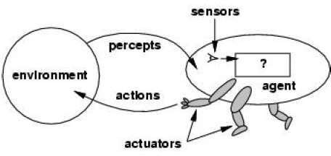
Percept
We use the term percept to refer to the agent's perceptual inputs at any
given instant.
Percept Sequence
An agent's percept sequence is the complete history of everything the
agent has ever perceived.
Agent function
Mathematically speaking, we say that an agent's behavior is described by the agent

Slide 36
Specifying the Agent’s Task Environment
Performance measure
Environment
Actuators
Sensors
PEAS
All these are grouped together under the heading of the task environment.
We call this the PEAS (Performance, Environment, Actuators, Sensors) description.
In designing an agent, the first step must always be to specify
the task environment as fully as possible.
The following table shows PEAS description of the task environment for an automated taxi.

Slide 37
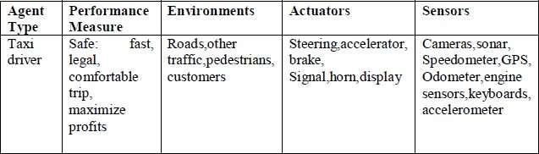
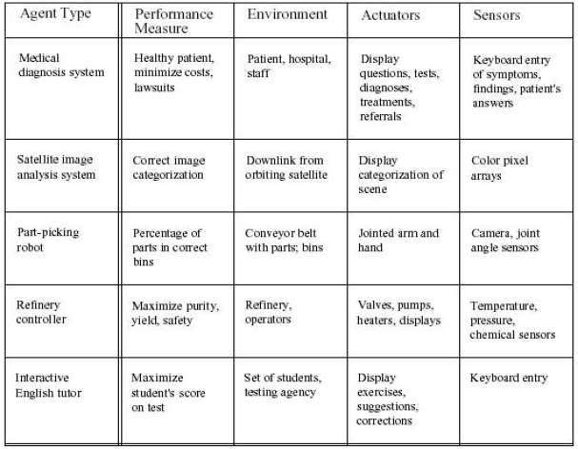

Slide 38
Properties of Task Environments
Fully observable vs. partially observable
Deterministic vs. stochastic
Episodic vs. sequential
Static vs. dynamic
Discrete vs. continuous
Single agent vs. multiagent
Fully observable vs. partially observable.
If an agent's sensors give it access to the complete state of the environment at each point in time, then we say that the task environment is fully observable.
A task environment is effectively fully observable if the sensors detect all
aspects that are relevant to the choice of action;
An environment might be partially observable because of noisy and inaccurate sensors or because parts of the state are simply missing from the sensor data.

Slide 39
Deterministic vs. stochastic.
If the next state of the environment is completely determined by the current state and the action executed by the agent, then we say the environment is deterministic;
Otherwise, it is stochastic.
Episodic vs. sequential
In an episodic task environment, the agent's experience is divided into atomic episodes.
Each episode consists of the agent perceiving and then performing a single action. Crucially, the next episode does not depend on the actions taken in previous episodes.
For example, an agent that has to spot defective parts on an assembly line bases each decision on the current part, regardless of previous decisions;
In sequential environments, on the other hand, the current decision
Could affect all future decisions.
Chess and taxi driving are sequential:

Slide 40
Discrete vs. continuous.
The discrete/continuous distinction can be applied to the state of the environment, to the way time is handled, and to the percepts and actions of the agent.
For example, a discrete-state environment such as a chess game has a finite number of distinct states.
Chess also has a discrete set of percepts and actions.
Taxi driving is a continuous- state and continuous-time problem:
The speed and location of the taxi and of the other vehicles sweep through a
range of continuous values and do so smoothly over time.
Taxi-driving actions are also continuous (steering angles, etc.)
Single agent vs. multiagent.
An agent solving a crossword puzzle by itself is clearly single-agent
environment,
in
a
Where as an agent playing chess is in a two-agent environment.
Multiagent is further classified in to two ways
Competitive multiagent environment
Cooperative multiagent environment

Slide 41
Types of Agent’s Architecture
Simple Reflex Agent
Model-based Reflex Agent
Goal-based Agents
Utility-based Agent
Learning Agent

Slide 42
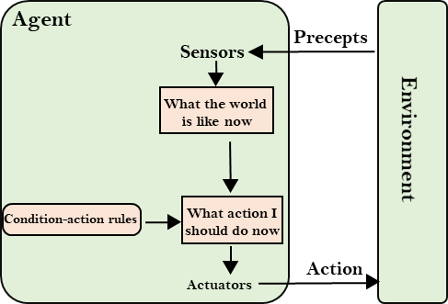
1. Simple Reflex Agent
The Simple reflex agents are the simplest agents. These agents take decisions on the basis of the current percepts and ignore the rest of the percept history.
These agents only succeed in the fully observable environment.
The Simple reflex agent does not consider any part of percepts
history during their decision and action process.
The Simple reflex agent works on Condition-action rule, which means it maps the current state to action. Such as a Room Cleaner agent, it works only if there is dirt in the room.

Slide 43
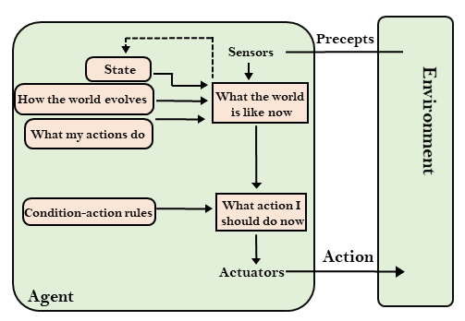
2. Model-based Reflex Agent
The Model-based agent can work in a partially observable environment, and track the situation.
A model-based agent has two important factors:
Model: It is knowledge about "how things happen in the world," so it is
called a Model-based agent.
Internal State: It is a representation of the current state based on
percept history.
These agents have the model, "which is knowledge of the world" and based
on the model they perform actions.
Updating the agent state requires information about:
How the world evolves
How the agent's action affects the world.

Slide 44
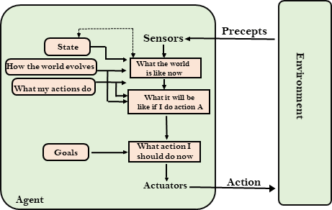
3. Goal-based Agents
The knowledge of the current state environment is not always sufficient
to decide for an agent to what to do.
The agent needs to know its goal which describes desirable situations.
Goal-based agents expand the capabilities of the model-based agent by
having the "goal" information.
They choose an action, so that they can achieve the goal.

Slide 45
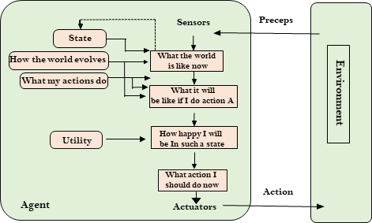
4. Utility-based Agents
These agents are similar to the goal-based agent but provide an extra component of utility measurement which makes them different by providing a measure of success at a given state.
Utility-based agent act based not only goals but also the best
way to achieve the goal.
The Utility-based agent is useful when there are multiple possible
alternatives, and an agent has to choose in order to perform the best action.

Slide 46
5. Learning Agents
A learning agent in AI is the type of agent which can learn from its past experiences, or it has learning capabilities.
It starts to act with basic knowledge and then able to act and adapt automatically through learning.
A learning agent has mainly four conceptual components, which are:
Learning element: It is responsible for making improvements by learning from environment
Critic: Learning element takes feedback from critic which describes that how well the agent is doing with respect to a fixed performance standard.
Performance element: It is responsible for selecting external action
Problem generator: This component is responsible
for suggesting actions that will lead to new and
informative experiences.
46

Slide 47
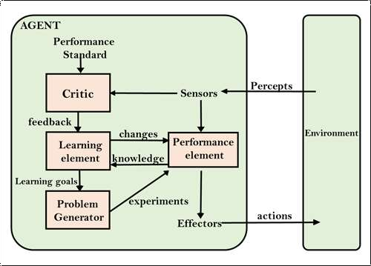

Slide 48
Performance Measures (Criteria for Success)
The performance measure that defines the criterion of success of an Agent’s behavior.
–The agent's prior knowledge of the environment.
–The actions that the agent can perform.
–The agent's percept sequence.

Slide 49
AI Problem Solving
Before solving the problem, we must understand the problem clearly
To solve the problem we need the formal description of the problem
What are aspects to understand the problem?
What is the goal of the problem? (Goal Formulation)
What is the implicit criteria for success? (how success is defined?
What is the initial situation?
Ability to perform?
(what are the procedures?)

Slide 50
Well Defined Problem
The process of deciding what actions and states to be considered is called as “Problem Formulation”.
The solution of many problems can be described by finding a sequence of actions that lead to a desirable goal.
Components of Well Defined Problem:
Initial state (Where the agent starts in)
Successor Function (Description of the possible actions)
State Space (Set of all possible actions)
Path Cost (Cost to reach the Goal)
Goal Test (Determines whether a given state is final state or not? Eg: Checkmate in Chess is Goal)

Slide 51
Types of Problem Formulation
Incremental Formulation | Complete State Formulation
Staring with empty set | Some basic configuration is represented in the initial state
Generates many sequences | It will work based on the actions
Memory requirements is less | Memory requirements is high

Slide 52
Phases in Problem Solving
What are the procedures to be followed in order to find the solution for a problem
Problem Definition
Problem Analysis (i/p?, environment?, expected o/p?)
Knowledge Representation (Data Structures?)
Technique (Selection of best technique)

Slide 53
Problem-solving agents
A Problem solving agent is a goal-based agent.
It decides what to do by finding sequence of actions that lead
to desirable states.
Problem Solving Agent
Determines and generates
Sequence of Actions
generates
Successful States

Slide 54
Steps in Problem Solving
Step 1: Goal Setting
Step 2: Goal Formulation
-> to observe the current state
-> to tabulate agent performance measures
Step 3: Problem Formulation
-> what will be the sequence of actions?
-> what will be the sequence of states?
Step 4: Search in unknown environment (Learning)
Step 5: Execution Phase

Slide 55
Types of Problems
Toy Problems
8 -Queens problem
Vacuum World
Ball Picker Robot
Real World Problems
Route Finding Problem
Travelling Salesman Problem
Robot Navigation

Slide 56
8 Queens Problem
Problem Statement: 8X8 Chess Board
Objective: No two queens are attacking by horizontally, vertically and diagonally
Step 1: Initial state -> No queens on the board Step 2: Successor Function -> Insert a Queen Step 3: Goal Test -> Check whether all 8
Queens are placed or not
Step 4: Path Cost (Total no of moves)
Step 5: State Space (How many solutions?)

Slide 57
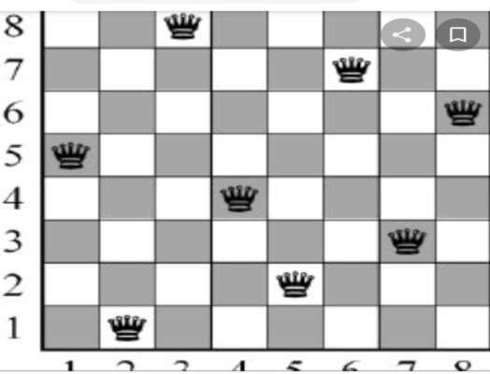
8 Queen’s Problem
Solution for

Slide 58
Problem Characteristics
Is the problem decomposable to smaller or easier problems?
Can problem solution steps be ignored or undone?
Ignorable: Solution steps can be ignored
Recoverable: Solution steps can be undone or
backtracking
Irrecoverable: Moves cannot be retracted
Is the problem universe predictable?
Problem with certain outcome(8 Queens)
Problem with uncertain outcome(Chess)
Is a good solution absolute or relative?
Is the solution a state or a path?
Is the problem using knowledge base?
What is the role of the knowledge?
Does the task require a periodic human interaction with computer?

Slide 59
State Space Search
A state space represents a problem in terms of states and operators that change states.
A state space consists of:
A representation of the states the system can be in. For example, in a board game, the board represents the current state of the game.
A set of operators that can change one state into another state. In a board game, the operators are the legal moves from any given state. Often the operators are represented as programs that change a state representation to represent the new state.
An initial state.
A set of final states; some of these may be desirable, others undesirable. This set is often represented implicitly by a program that detects terminal states.

Slide 60
The Water Jug Problem
In this problem, we use two jugs called four and three; four holds a maximum of four gallons of water and three a maximum of three gallons of water. How can we get two gallons of water in the four jug?
The state space is a set of prearranged pairs giving the number of gallons of water in the pair of jugs at any time, i.e., (four, three) where four = 0, 1, 2, 3 or 4 and three = 0, 1,
2 or 3.
The start state is (0, 0) and the goal state is (2, n) where n may be any but it is limited to three holding from 0 to 3 gallons of water or empty. Three and four shows the name and numerical number shows the amount of water in jugs for solving the water jug problem. The major production rules for solving this problem are shown below:

Slide 61
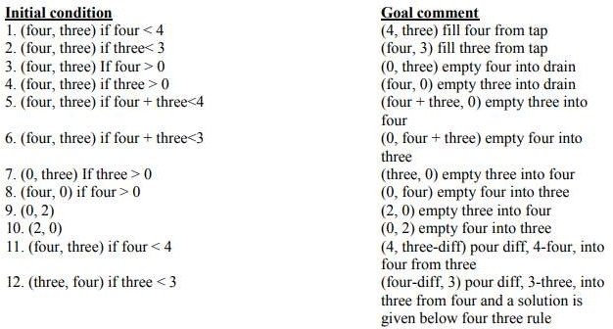

Slide 62
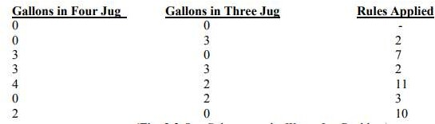

Slide 63
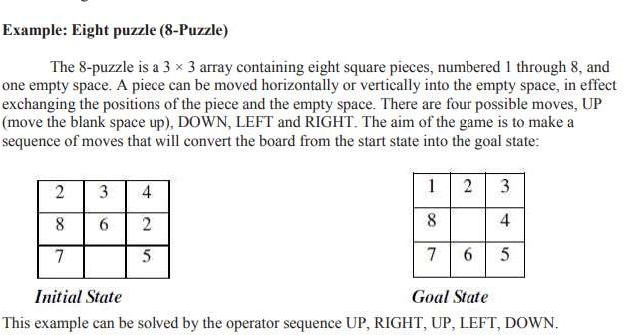

Slide 64
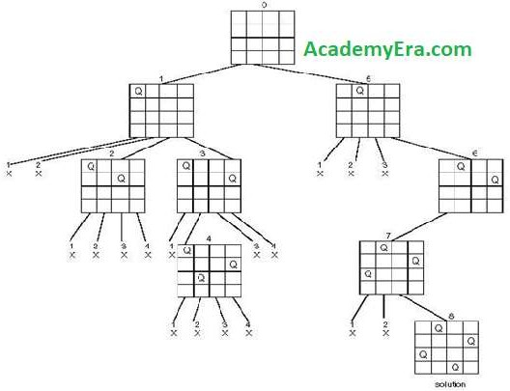
State Space Tree for 4 - Queens Problem

Slide 65
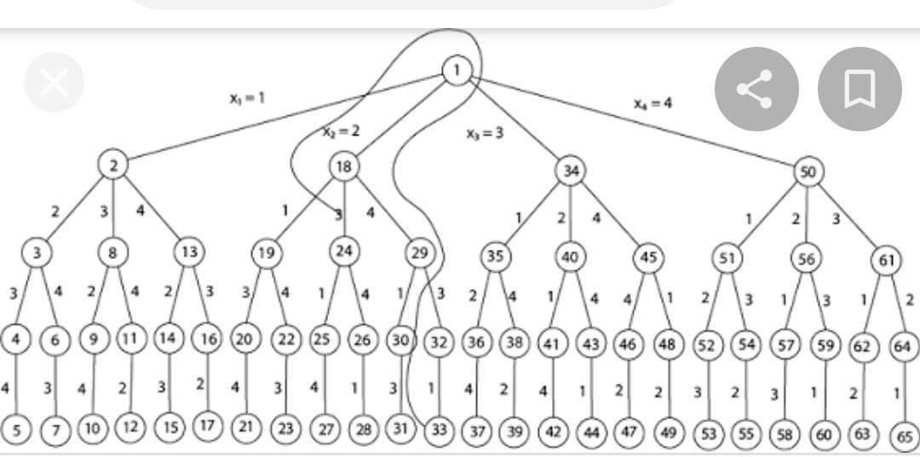
State Space Tree for 8
Queen’s Problem

Slide 66
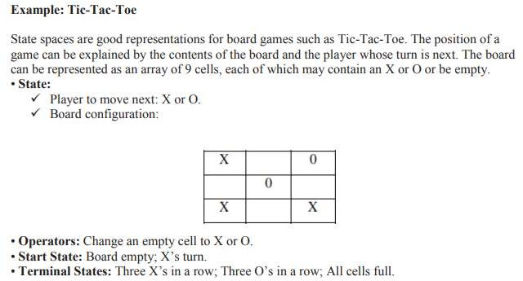

Slide 67
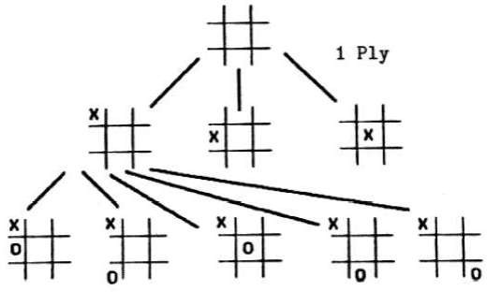
Search Tree for Tic-Tac-Toe Game
The sequence of states formed by possible moves is called a search tree. Each level of the tree is called a ply.

Slide 68
Tree (Data Structure)
A tree data structure can be defined recursively as a collection of nodes (starting at a root node), where each node is a data structure consisting of a value, together with a list of references to nodes (the "children"), with the constraints that no reference is duplicated, and none points to the root.
Terminology used in Trees:
Node
A node is a structure which may contain a value or condition, or
represent a
separate data structure.
Root
The top node in a tree, the prime ancestor.
Child
A node directly connected to another node when moving away from
the root,
an immediate descendant.
Parent
The converse notion of a child, an immediate ancestor.
Siblings
A group of nodes with the same parent.
68

Slide 69
Neighbor
Parent or child.
Descendant
A node reachable by repeated proceeding from parent to child. Also
known
as subchild.
Ancestor
A node reachable by repeated proceeding from child to parent.
Leaf / External node (not common)
A node with no children. Branch node / Internal node A node with at least one child. Degree
For a given node, its number of children. A leaf is necessarily degree
zero. The degree of a tree is the degree of its root.
Degree of tree
The degree of the root.
Edge
The connection between one node and another.
Path
A sequence of nodes and edges connecting a node with a descendant.
69

Slide 70
Distance
The number of edges along the shortest path between two nodes.
Depth
The distance between a node and the root.Level1 + the number of
edges between a
node and the root, i.e. (Depth + 1)
Height
The number of edges on the longest path between a node and a descendant leaf.
Width
The number of nodes in a level.
Breadth
The number of leaves.
Height of tree
The height of the root node or the maximum level of any node in the
tree.
Forest
A set of n ≥ 0 disjoint trees.
Sub Tree
A tree T is a tree consisting of a node in T and all of its descendants in T.
Ordered Tree
A rooted tree in which an ordering is specified for the children of each
vertex.
Size of a tree
Number of nodes in the tree.
70

Slide 71
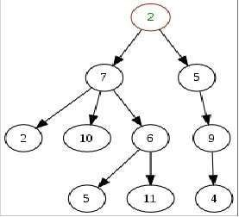
Example: Tree
A generic, and so non-binary, unsorted, some labels duplicated, arbitrary diagram of a tree. In this diagram, the node labeled 7 has three children, labeled 2, 10 and 6, and
one parent, labeled 2. The root node, at parent.
the top, has no
71

Slide 72
Tree Traversals
In-order Traversal
Pre-order Traversal
Post-order Traversal
In-order Traversal (Algorithm)
Until all nodes are traversed −
Step 1 − Recursively traverse left subtree.
Step 2 − Visit root node.
Step 3 − Recursively traverse right subtree.
Pre-order Traversal (Algorithm)
Until all nodes are traversed −
Step 1 − Visit root node.
Step 2 − Recursively traverse left subtree.
Step 3 − Recursively traverse right subtree.
72

Slide 73
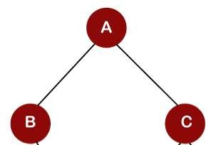
Post-order Traversal (Algorithm)
Until all nodes are traversed −
Step 1 − Recursively traverse left subtree. Step 2 − Recursively traverse right subtree. Step 3 − Visit root node..
In-order Traversal = B -> A -> C Pre-order Traversal = A -> B -> C Post-order Traversal = B -> C -> A

Slide 74
Graphs (Data Structures)
A graph is a pictorial representation of a set of objects where some pairs of objects are connected by links. The interconnected objects are represented by points termed as vertices, and the links that connect the vertices are
called edges.
Formally, a graph is a pair of sets (V, E), where V is the set of vertices and E is the set of edges, connecting the pairs of vertices. Take a look at the following graph −
In this graph,
V = {a, b, c, d, e}
E = {ab, ac, bd, cd, de}
A
B
C
D
E

Slide 75
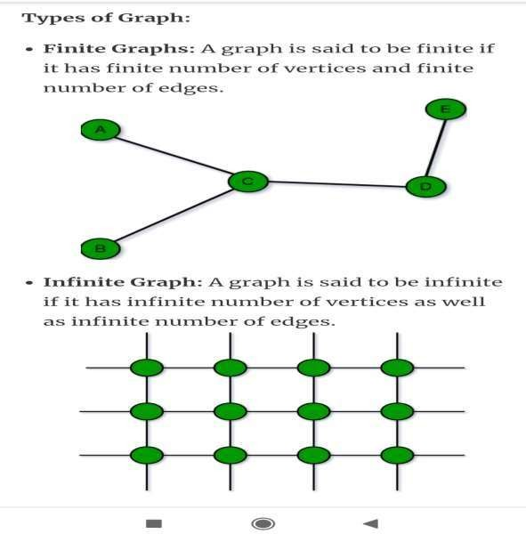

Slide 76
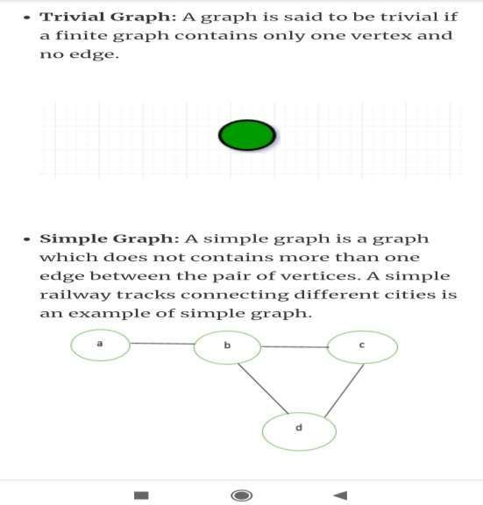

Slide 77
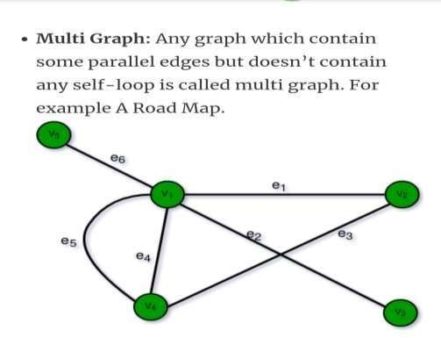

Slide 78
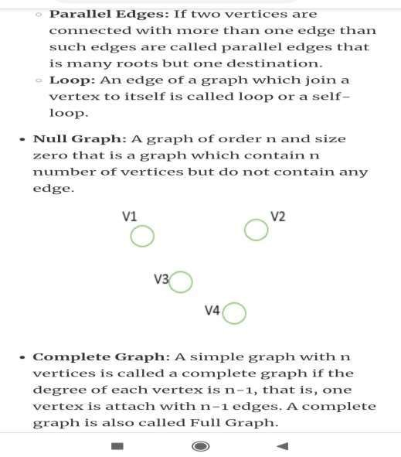

Slide 79
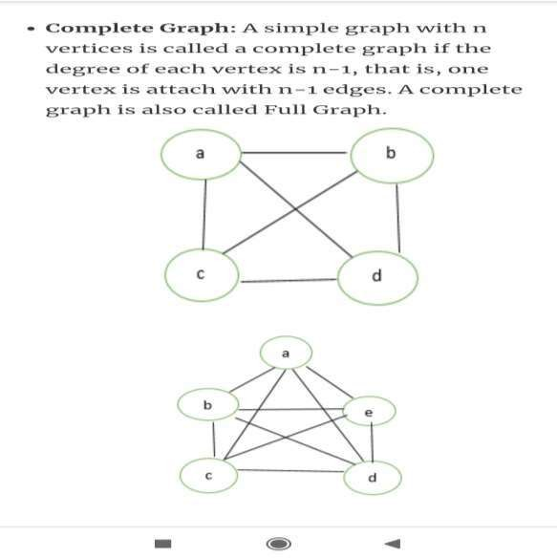

Slide 80
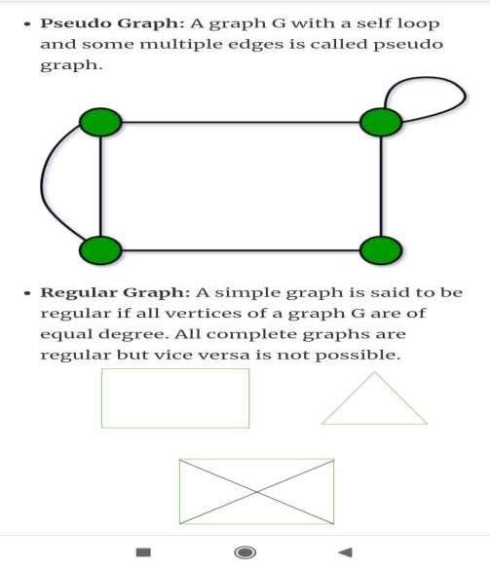

Slide 81
Search Algorithms
The process of finding an element in the data structure is called as “Searching”.
Search Graph is an algorithm that visits vertices and edges in
graph in an order based on the connectivity of the graph.
Components of Search Algorithm
A State Space: Set of all possible states where you can be.
A Start State: The state from where the search begins.
A Goal Test: A function that looks at the current state
returns whether or not it is the goal state.
The Solution to a search problem is a sequence of actions, called the plan that transforms the start state to the goal state.
This plan is achieved through search algorithms.

Slide 82
Search Terminology
Problem Space − It is the environment in which the search takes place. (A set of states and set of operators to change those states)
Problem Instance − It is Initial state + Goal state.
Problem Space Graph − It represents problem state. States are shown by nodes and operators are shown by edges.
Depth of a problem − Length of a shortest path or shortest sequence of operators from Initial State to goal state.
Space Complexity − The maximum number of nodes that are stored in memory.
Time Complexity − The maximum number of nodes that are created.
Admissibility − A property of an algorithm to always find an optimal solution.
Branching Factor − The average number of child nodes in the problem space graph.
Depth − Length of the shortest path from initial state to goal
state.
82

Slide 83
Properties of Search Algorithms:
Completeness: A search algorithm is said to be complete if it
guarantees to return a solution.
Optimality: If a solution found for an algorithm is guaranteed to be
the best solution (lowest path cost) among all other solutions.
Time Complexity: Time complexity is a measure of time for an algorithm to complete its task.
Space Complexity: It is the maximum storage space required at any
point during the search, as the complexity of the problem.
Problem-solving agents:
Rational agents or Problem-solving agents in AI mostly used these search strategies or algorithms to solve a specific problem and provide the best result. Problem- solving agents are the goal-based agents and use atomic representation.

Slide 84
Issues in the Design of Search Programs
Each search process can be considered to be a tree traversal. The object of the search is to find a path from the initial state to a goal state using a tree. The number of nodes generated might be huge; and in practice many of the nodes would not be needed. The secret of a good search routine is to generate only those nodes that are likely to be useful, rather than having a precise tree.
The following issues arise when searching:
The tree can be searched forward from the initial node to the goal
state or backwards from the goal state to the initial state.
To select applicable rules, it is critical to have an efficient procedure for matching rules against states.
How to represent each node of the search process? This is the knowledge representation problem or the frame problem. In games, an array suffices; in other problems, more complex data structures are needed.

Slide 85
Types of Search Algorithms
I. Brute-Force Search Strategies (Uninformed / Blind)
Breadth First Search (BFS)
Depth First Search (DFS)
Bidirectional Search
Uniform Cost Search
Iterative Deepening Depth-First Search
II. Informed (Heuristic) Search Strategies
Pure Heuristic Search (Open and Closed List)
Greedy Best First Search
A * Search
III. Local Search Algorithms
Hill-Climbing Search
Local Beam Search
Simulated Annealing
Travelling Salesman Problem

Slide 86
BREADTH FIRST SEARCH (BFS)
Breadth-first search in which the root node is expanded first, then all successors of the root node are expanded next, then their successors, and so on.
In general, all the nodes are expanded at a given depth in the search tree before any nodes at the next level are expanded.
Breath-first-search is implemented by calling TREE-SEARCH with an empty fringe that is a first-in-first-out(FIFO) queue, assuring that the nodes that are visited first will be expanded first.
In otherwards, calling TREE-SEARCH (problem, FIFO- QUEUE()) results in breadth-first-search.
The FIFO queue puts all newly generated successors at the end of the queue, which means that Shallow nodes are expanded before deeper nodes.

Slide 87
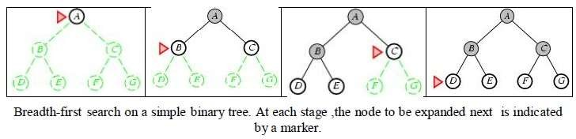

Slide 88
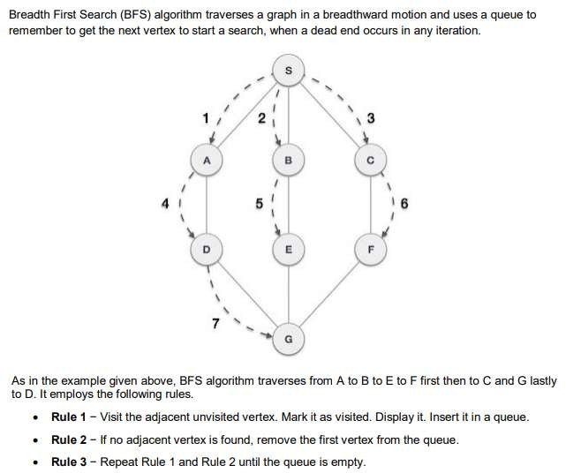
BFS - Example

Slide 89
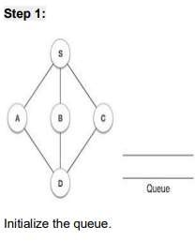
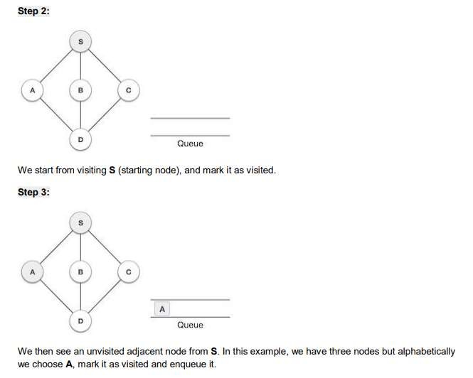

Slide 90
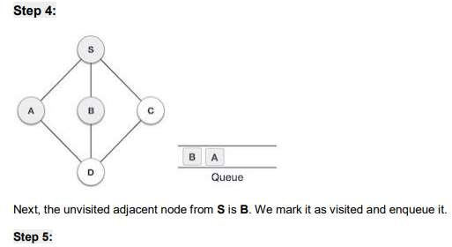
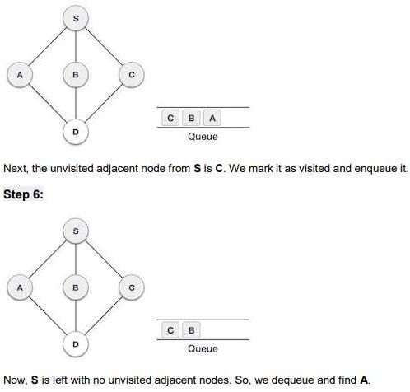

Slide 91
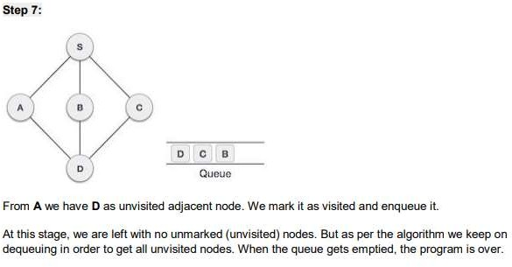

Slide 92
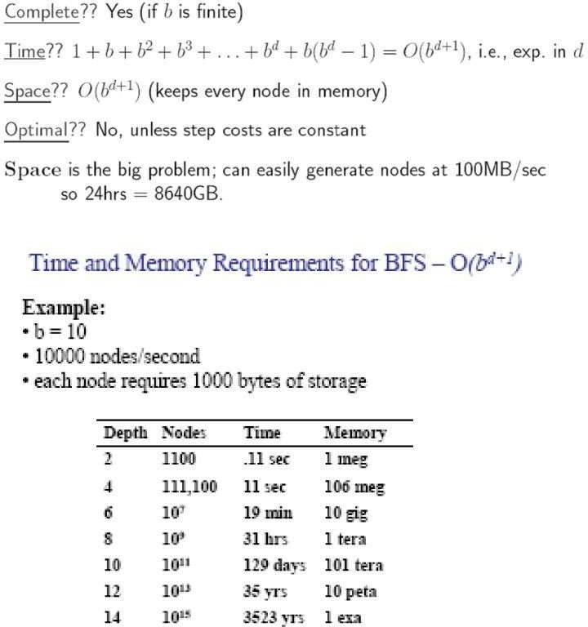
Properties of BFS

Slide 93
DEPTH FIRST SEARCH (DFS)
–Depth-first-search always expands the deepest node in the current fringe of
the search tree.
–The progress of the search is illustrated in figure.
–The search proceeds immediately to the deepest level of the
where the nodes have no successors.
–As those nodes are expanded, they are dropped from the fringe,
search tree,
–so then the search "backs up" to the next shallowest node that still has
unexplored successors.
–This strategy can be implemented by TREE-SEARCH with a last-in-first-
out (LIFO) queue, also known as a stack.
–Depth-first-search has very modest memory requirements.
–It needs to store only a single path from the root to a leaf node along with
the remaining unexpanded sibling nodes for each node on the path.
–Once the node has been expanded, it can be removed from the memory, as
soon as its descendants have been fully explored.
–For a state space with a branching factor b and maximum depth m, depth-
first-search requires storage of only bm + 1 nodes.

Slide 94
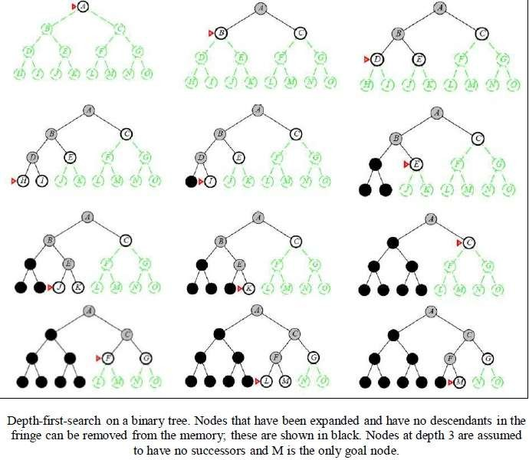

Slide 95
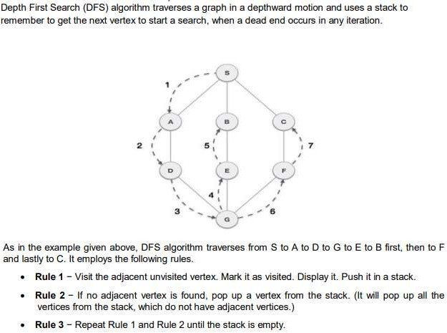
DFS - Example

Slide 96
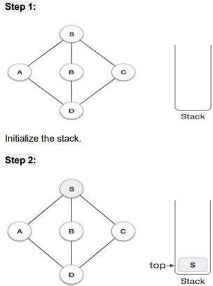
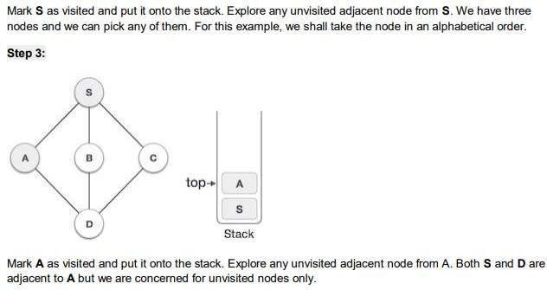

Slide 97
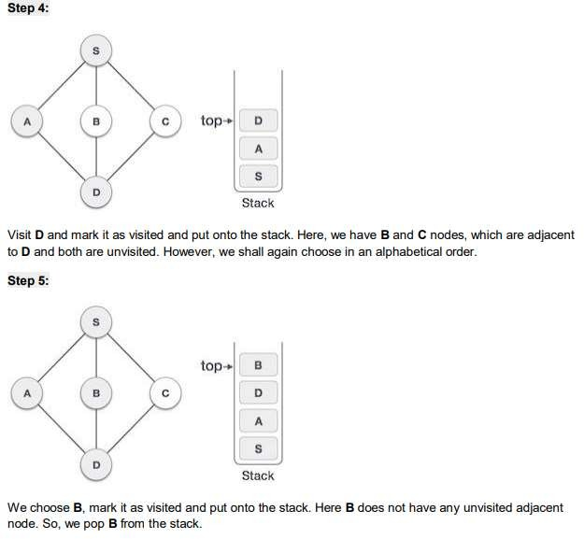

Slide 98
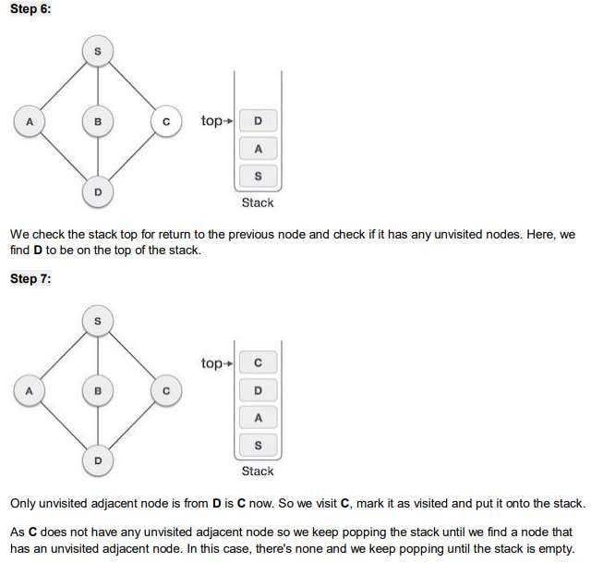

Slide 99
Parameters | BFS | DFS
Data structure | Queue (FIFO) | Stack (LIFO)
Source | It is better when target is closer to source | It is better when target is far from source
Speed | Slower | Faster
Time Complexity | O(V+E) | O(V+E)
Suitability for Decision Trees | BFS considers all neighbor, so it is not suitable for decision tree | Suitable for decision tree

